Slide 1
Introduction to Hadoop (Mod 1)
Prepared By: Dr. KIMMI KUMARI

Slide 2
Contents
Introduction to Big Data and its importance
The Hadoop
Anatomy of a YARN

Slide 3
Introduction to Big Data and its importance
Big Data is a term used for a collection of data sets that are large and complex.
The challenge includes
capturing
curating
storing
searching
sharing
visualization

Slide 4
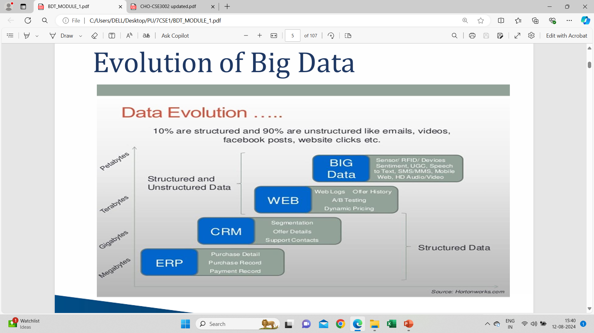

Slide 5
Traditional v/s Big data approach
On the Basis of
Usage
Data Size
Data Integration
Schema
Traditional & Big Data can be compared effectively.

Slide 6
Types of Big Data
Unstructured
Quasi-Structured
Semi-Structured
Structured

Slide 7
Characteristics of Big Data
Volume
Velocity
Variety
Veracity
Value

Slide 8
Applications Of Big Data
Smarter HealthCare
Telecom
Retail
Traffic control
Manufacturing
Search Quality

Slide 9
The Big Data Technology Landscape: No SQL(Not Only SQL)
The term NoSQL was first coined by Carlo Strozzi in 1998.
NoSQL is light weight, open-source, non-relational database.
NoSQL may support SQL-like query languages.
NoSQL databases are used in real-time web applications.

Slide 10
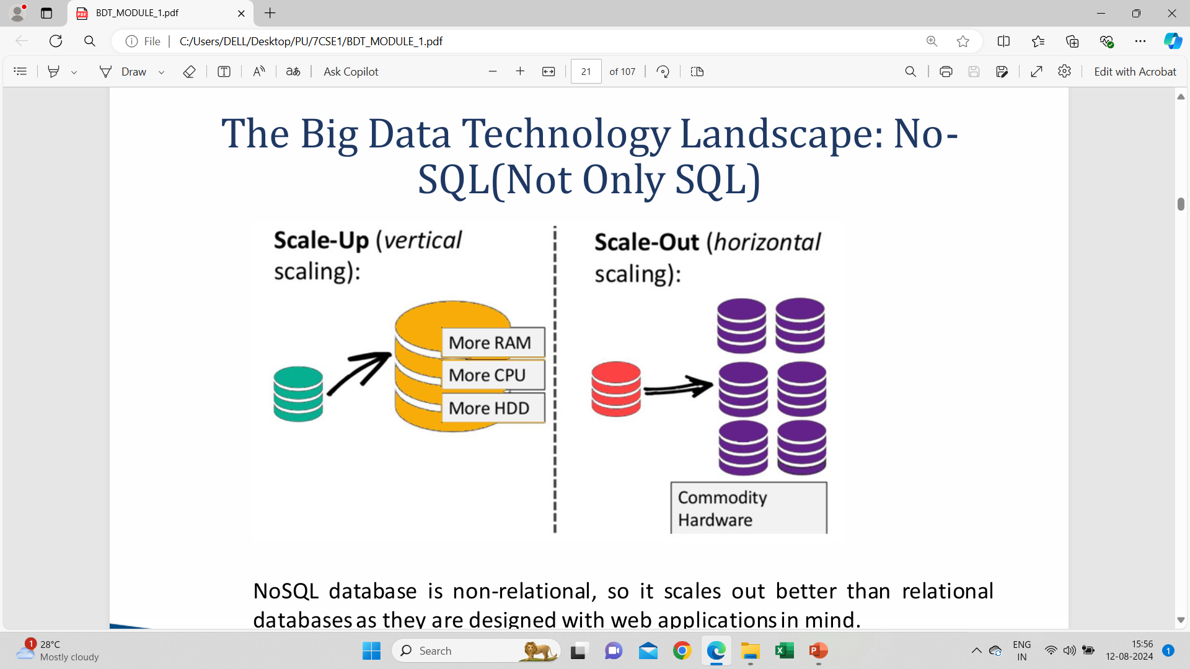

Slide 11
Advantages of NoSQL
Can easily scale up and down
It is pretty flexible
Affordable
Easily Implemented

Slide 12
Types of NoSQL Databases
Key-value Pair Based
Column-oriented Graph
Graphs based
Document-oriented

Slide 13
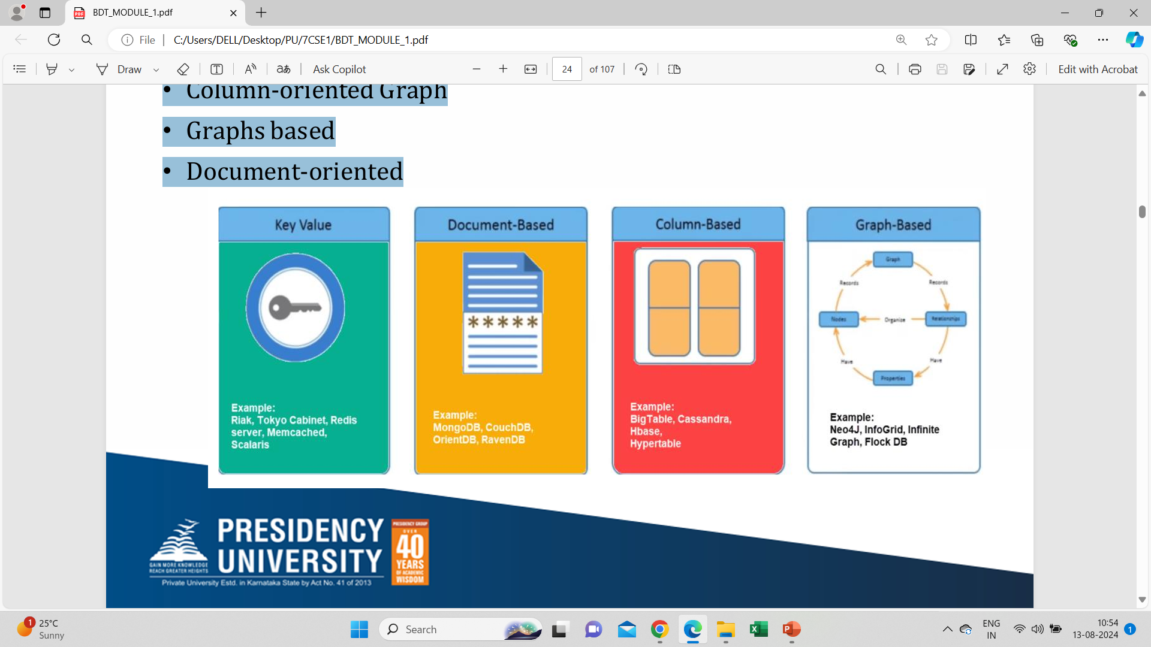

Slide 14
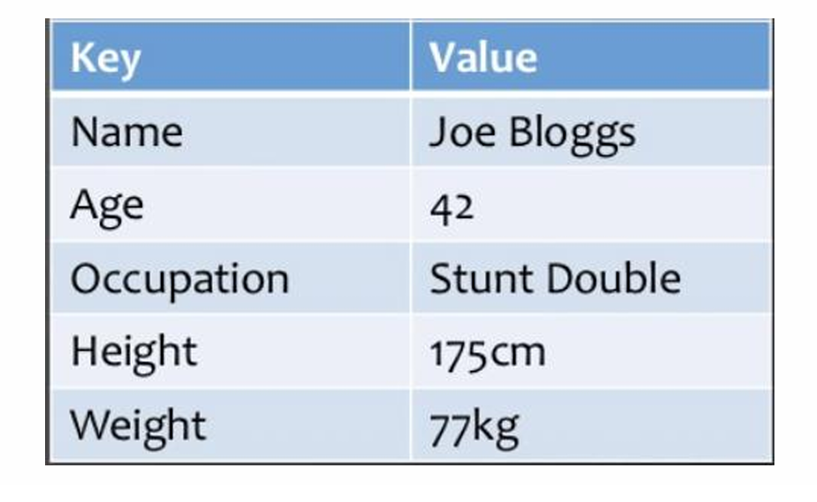
Key-value Pair Based

Slide 15
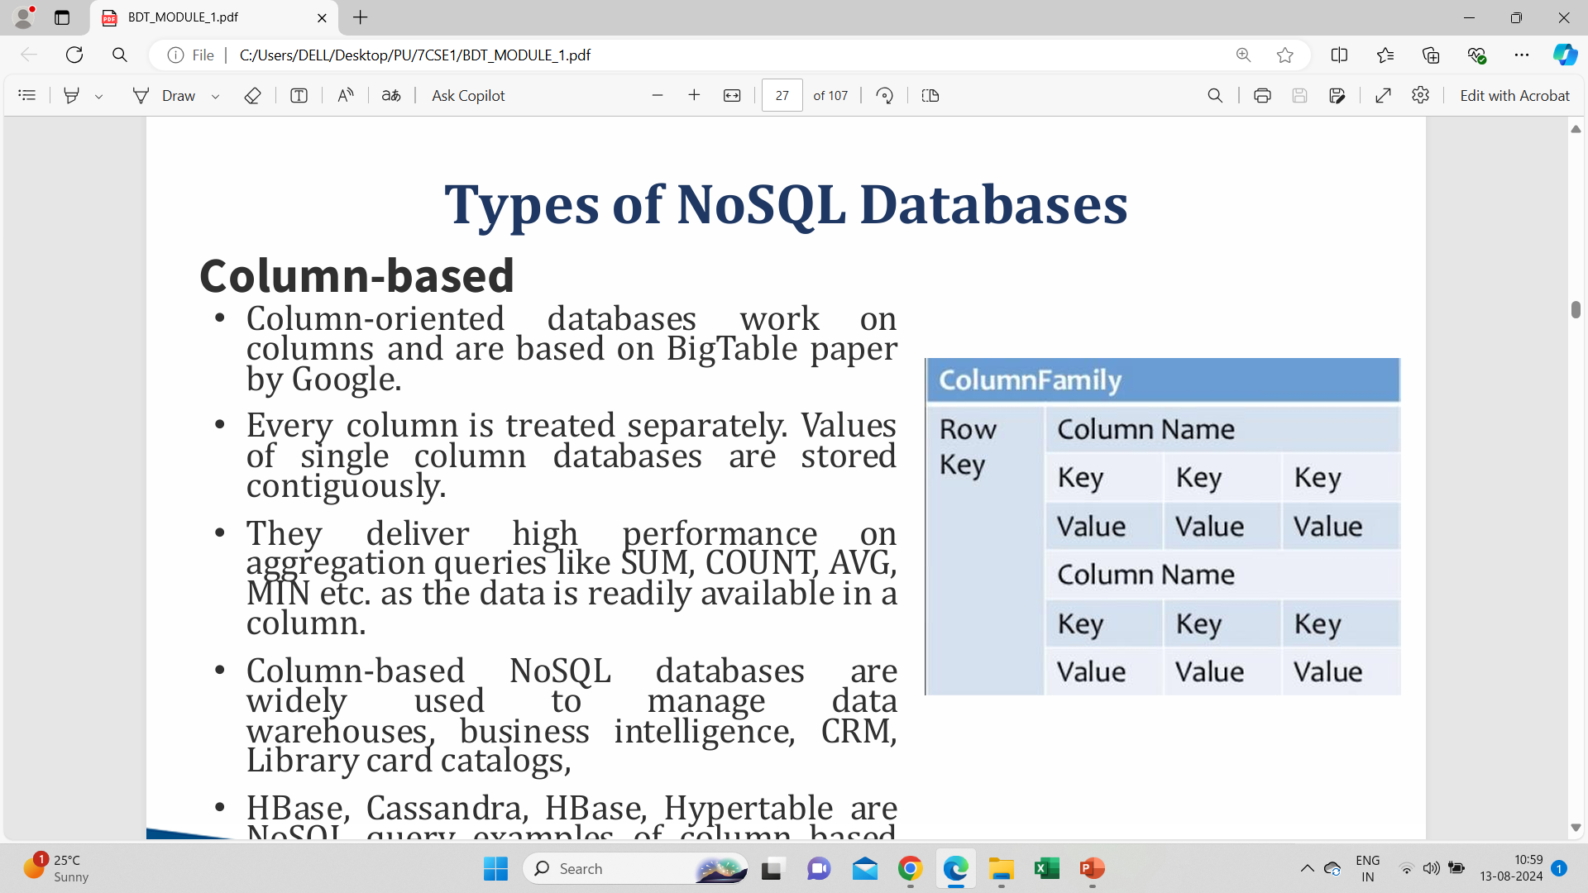
Column-based

Slide 16
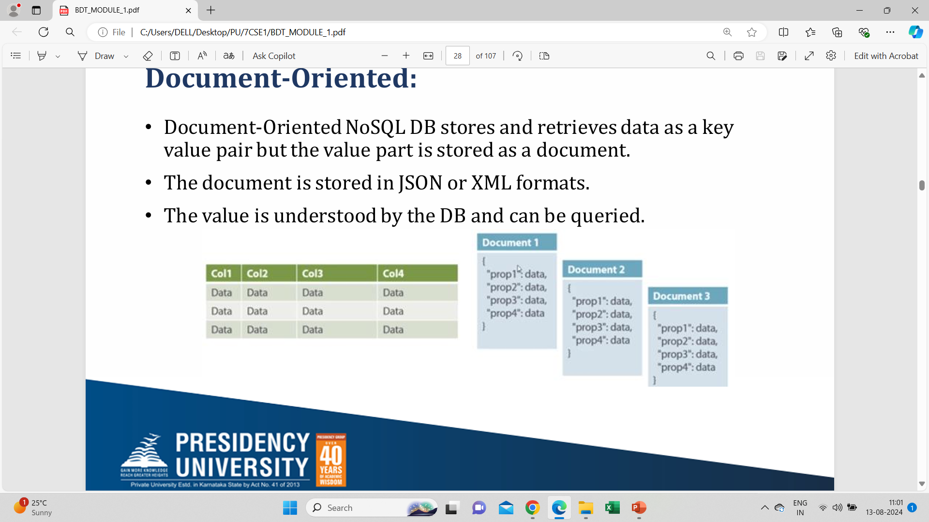
Document-Oriented

Slide 17
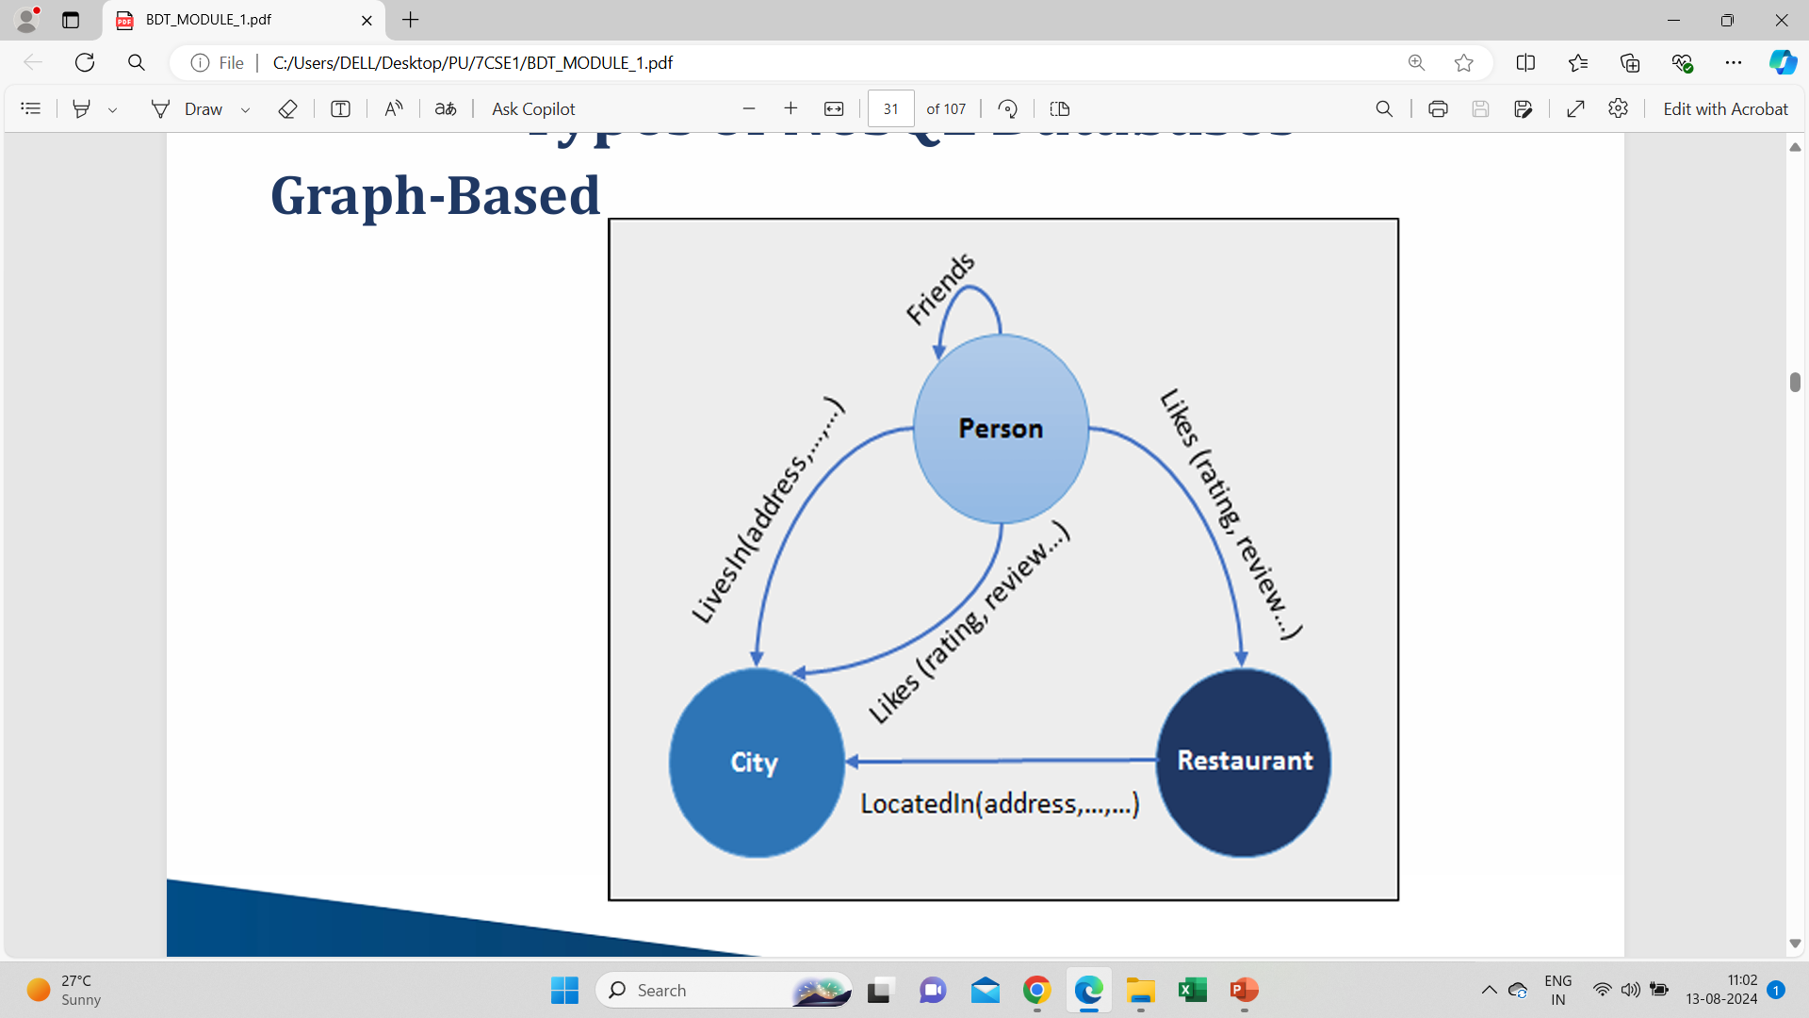
Graph-Based

Slide 18
Hadoop
Open-source software framework
licensed under the Apache v2 license
written in the Java programming language

Slide 19
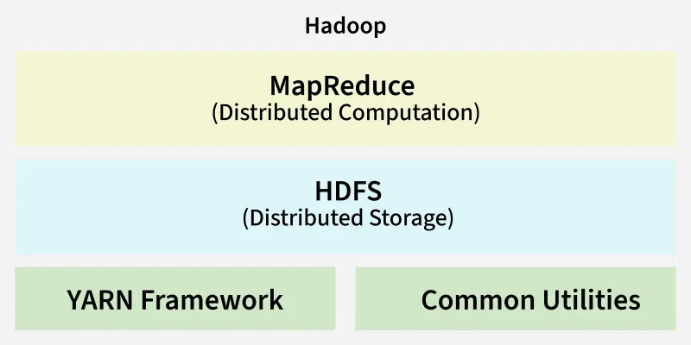
Hadoop Architecture Overview

Slide 20
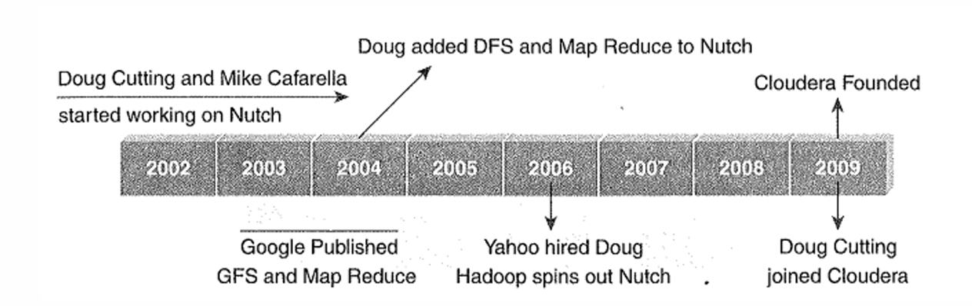
History of Hadoop

Slide 21
USE CASE OF HADOOP
The ClickStream analysis using Hadoop provides three key benefits:
Understand customer behavior
Store years of data without ample incremental cost
Organize ClickStream data
Improve User’s business

Slide 22
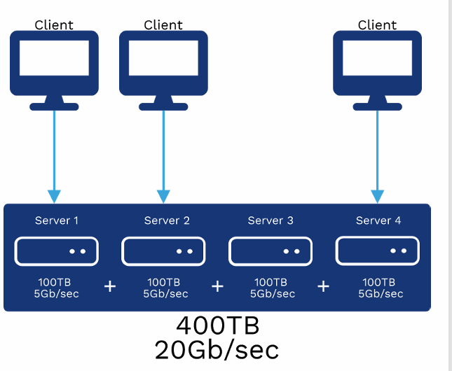
Distributed File System

Slide 23
Distributed File System
DFS has two components in its services, and these are as follows:
Local Transparency
Redundancy

Slide 24
Applications of Distributed File System
There are several applications of the distributed file system. Some of them are as follows:
Hadoop
NFS (Network File System)
SMB (Server Message Block)
NetWare

Slide 25
Hadoop Distributed File System
Block structured file system
Master/Slave Architecture
support Java

Slide 26
Name Node
Master node in the Apache Hadoop HDFS Architecture.
Highly available server

Slide 27
Data Node
Slave nodes in HDFS
Commodity hardware
Stores the data

Slide 28
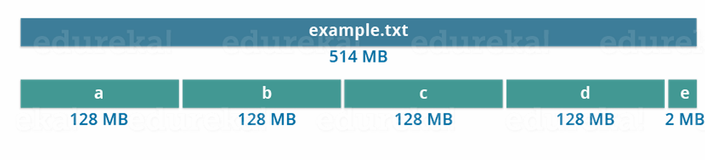
Blocks
Smallest continuous location on your hard drive
Store the data as a collection of blocks
Default size of each block is 128 MB in Apache Hadoop 2.x

Slide 29
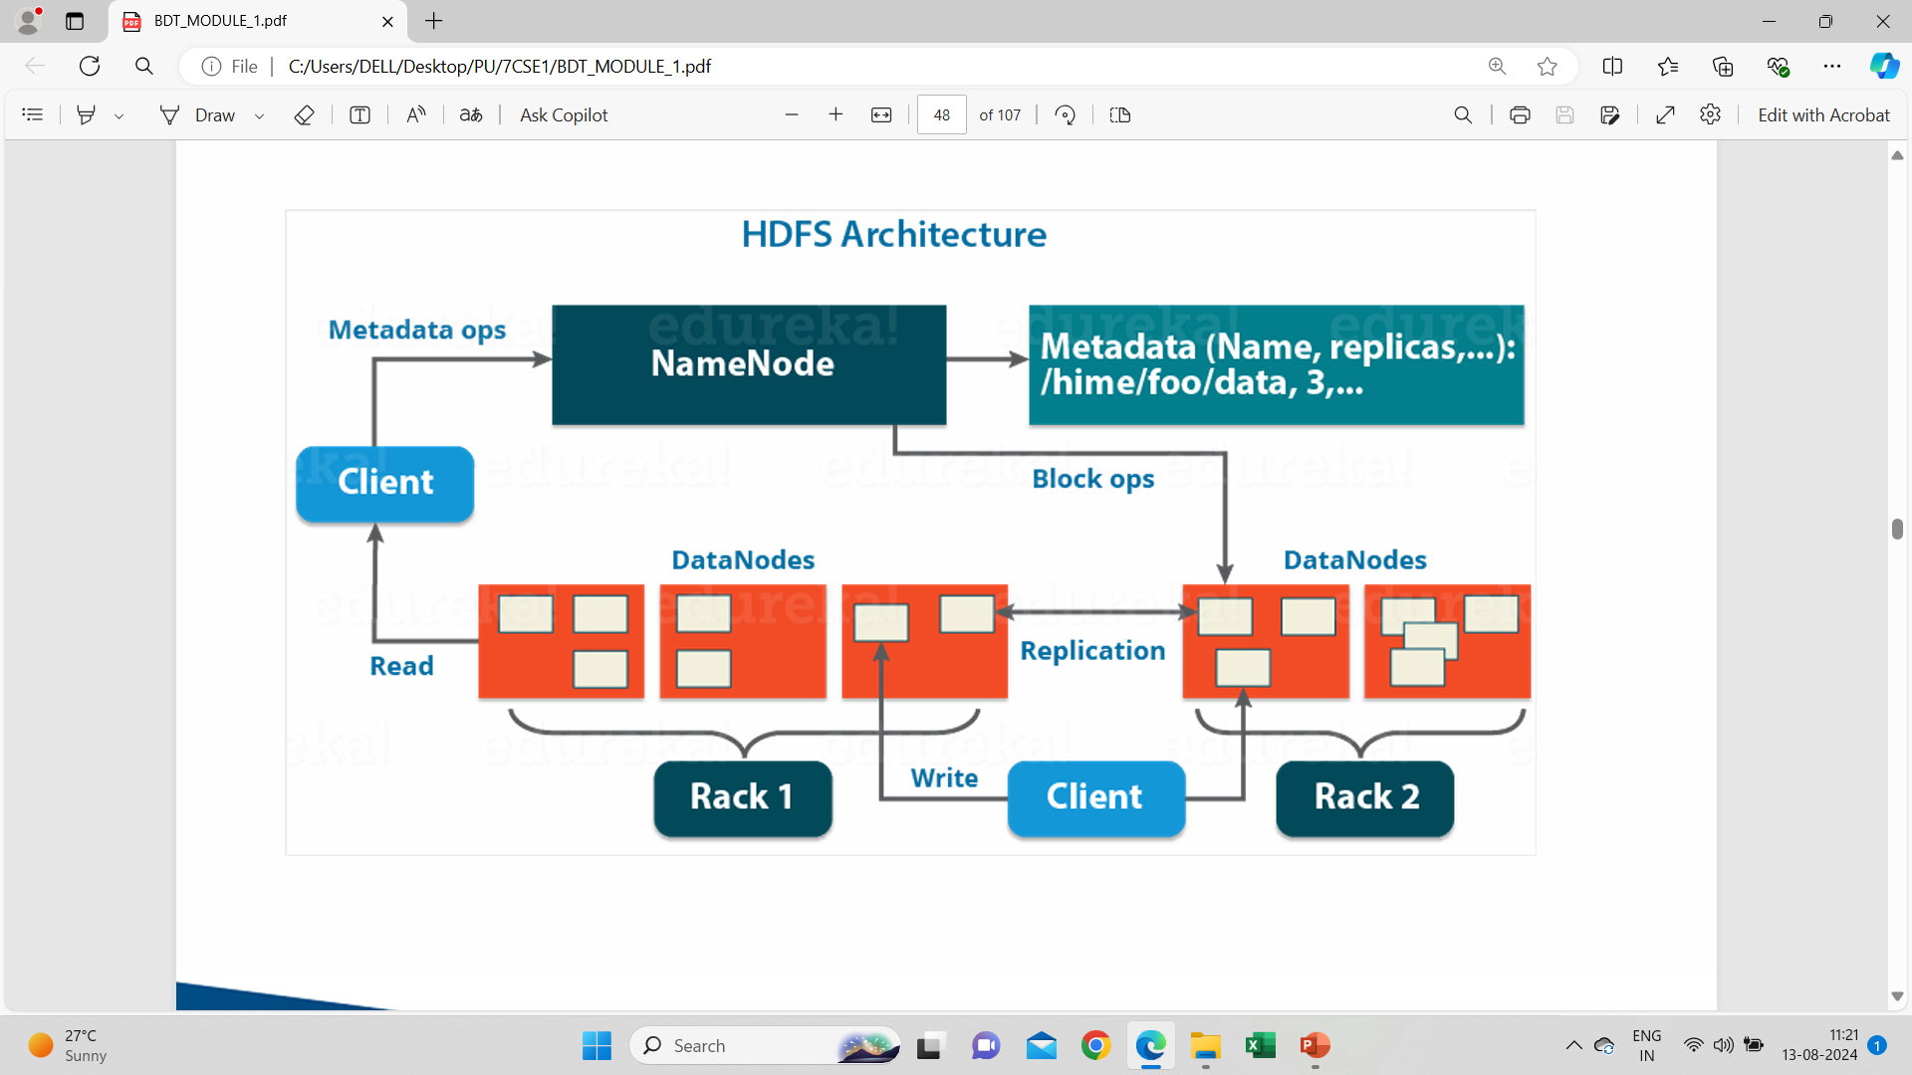

Slide 30
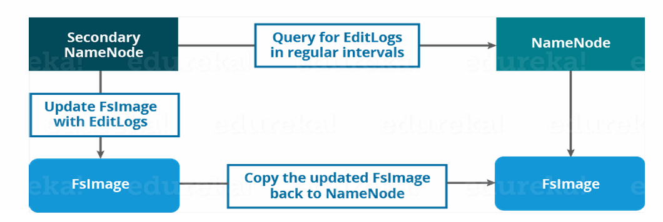
Secondary Name Node
Third daemon or a process
Helper daemon

Slide 31
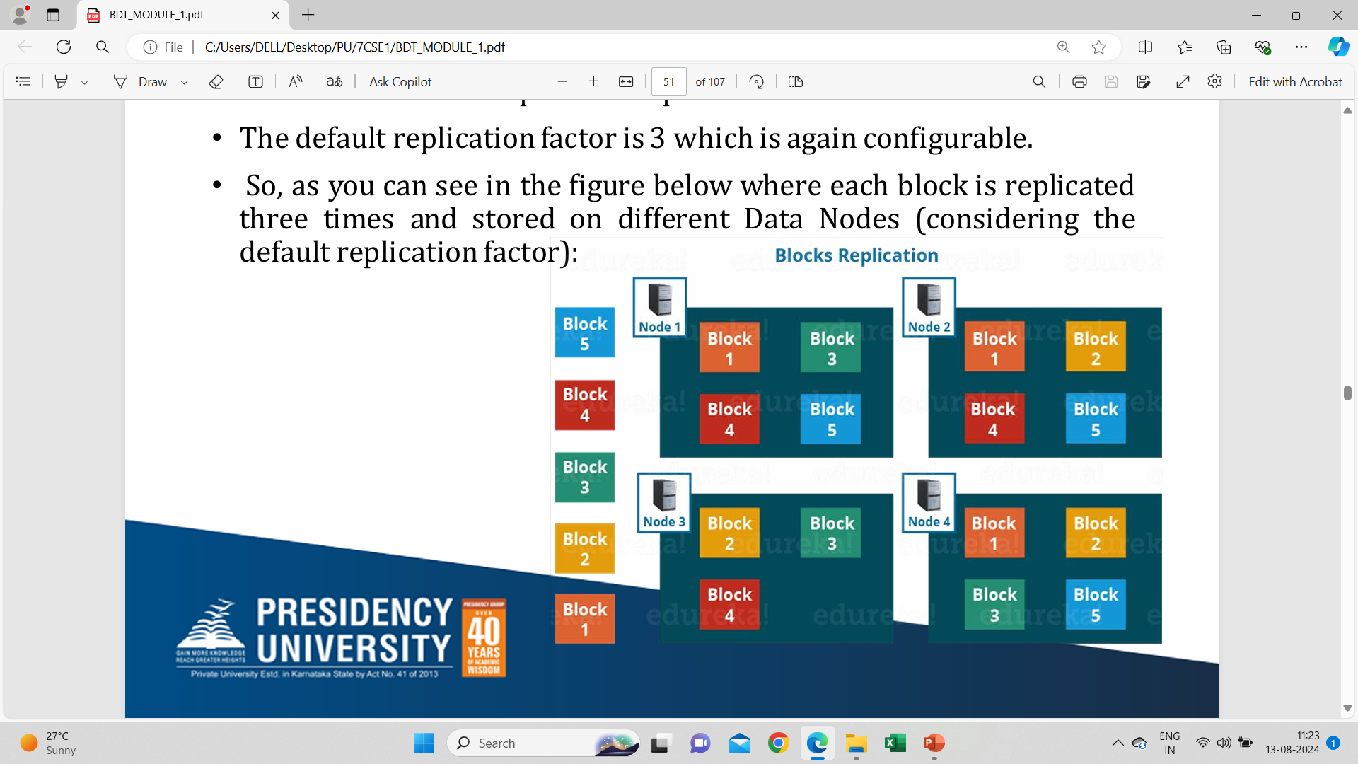
Replication Management

Slide 32
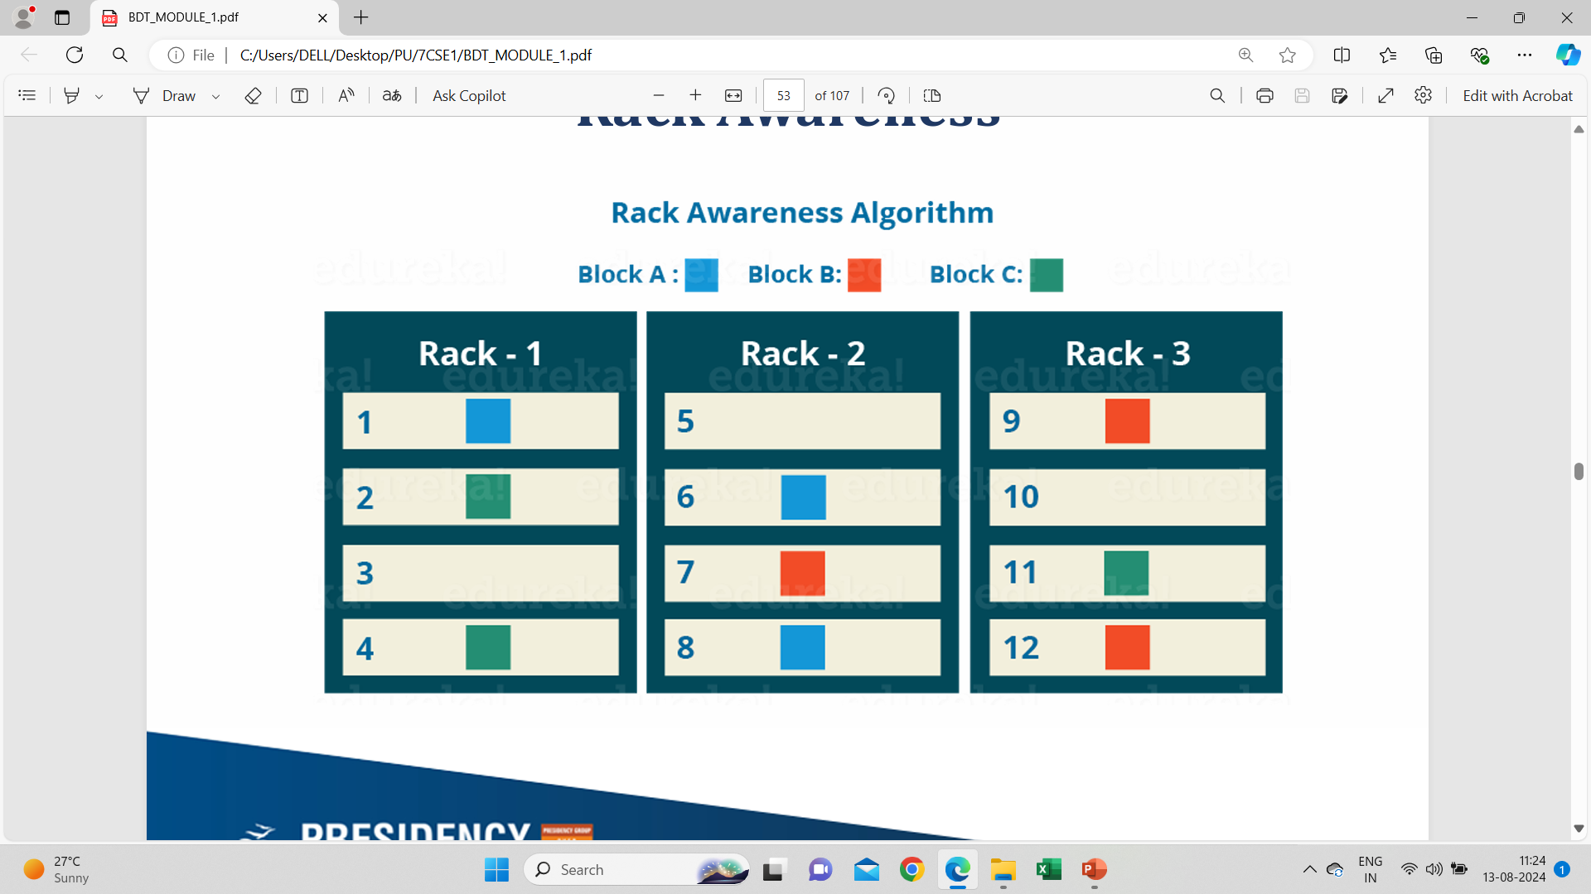
Rack Awareness

Slide 33
Limitations of Hadoop 1.0 Architecture
Expensive
Limit on the number of objects
Overwhelmed with load
In Hadoop 2.x, this is resolved with the help of HDFS Federation

Slide 34
HDFS Federation
Name Nodes are independent of each other
Data Nodes are common storage for blocks
Data Nodes shared by all Name Nodes
Active-Passive Name Node handles failover automatically

Slide 35
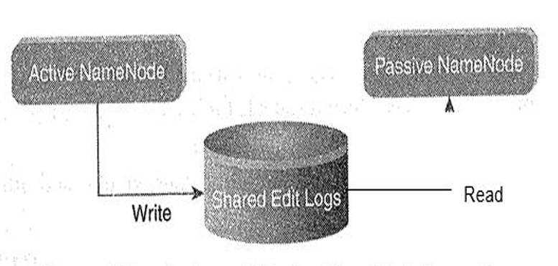
Passive & Active NameNode

Slide 36
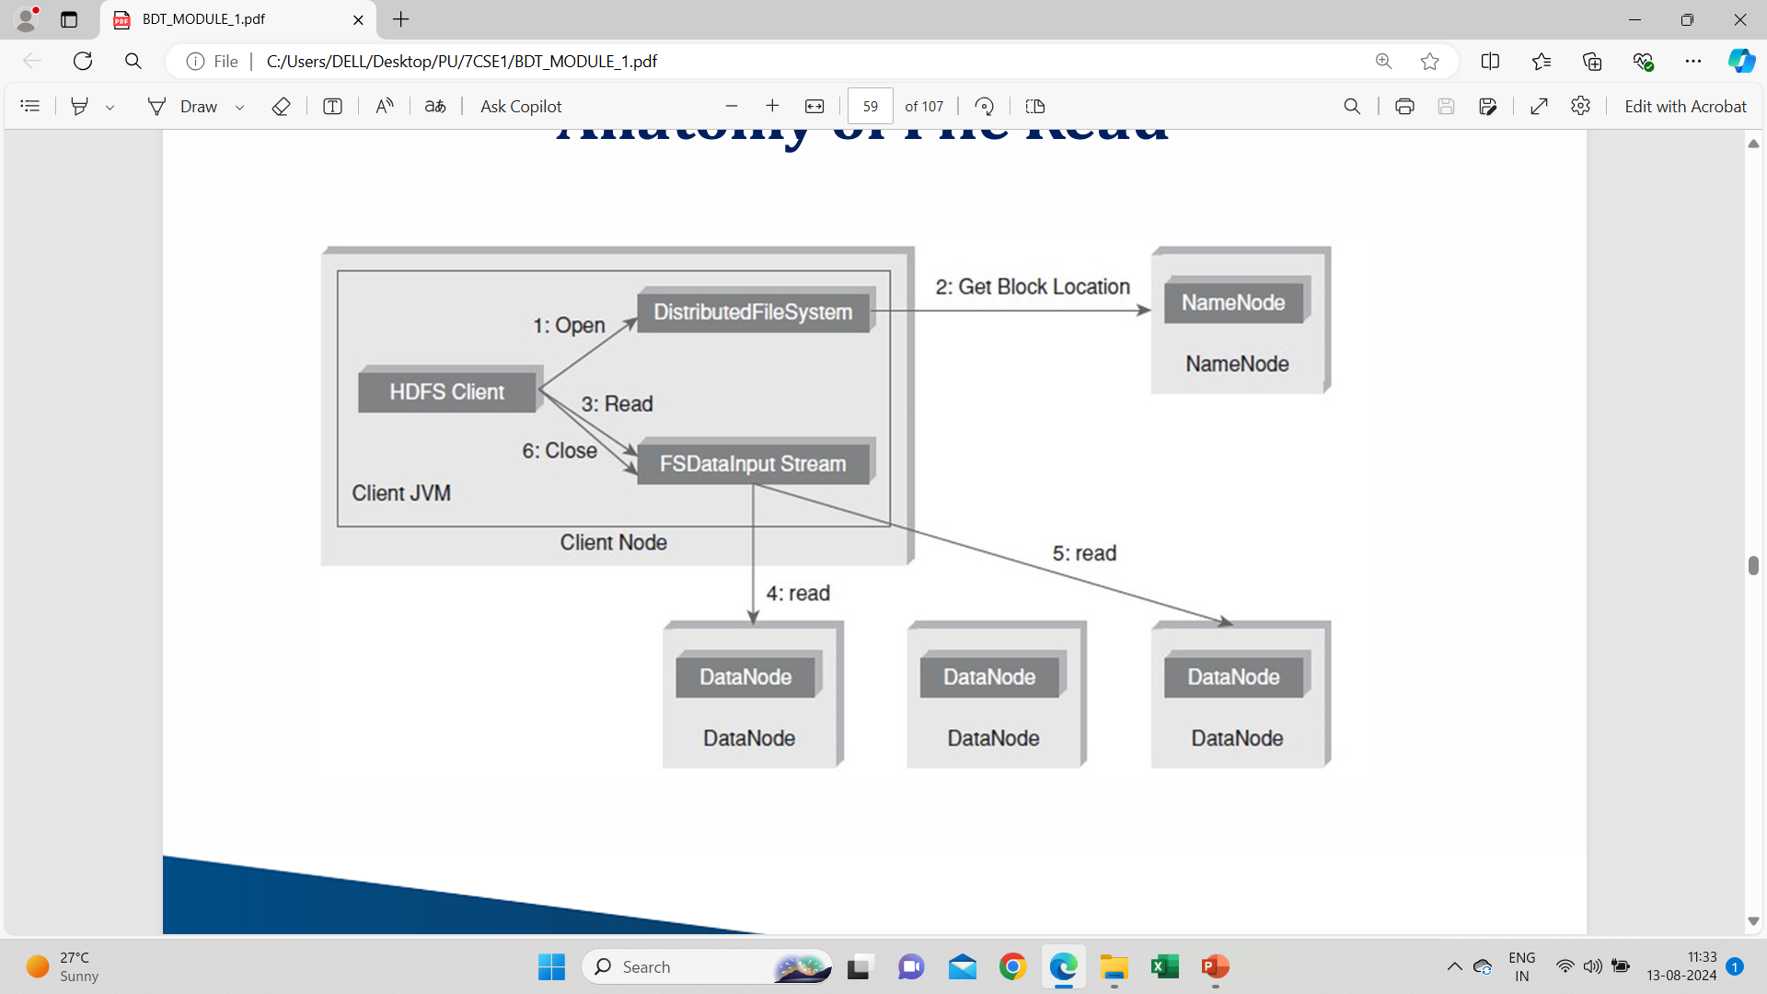
Anatomy of File Read

Slide 37
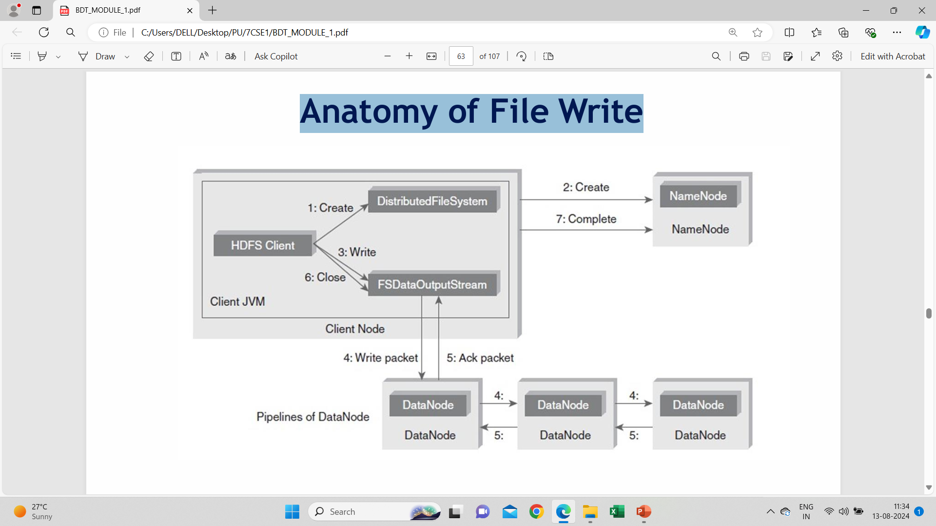
Anatomy of File Write

Slide 38
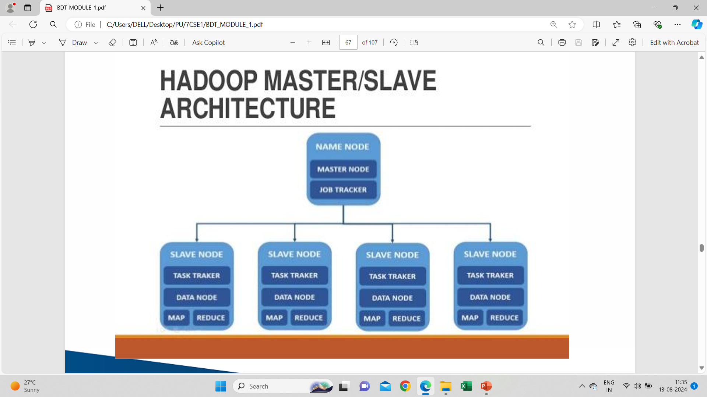

Slide 39


Slide 40
Hadoop Mapreduce paradigm
Storing and processing large datasets.
Ranging in size from gigabytes to petabytes.
Allows parallel processing over the data

Slide 41
Why Hadoop?
Cost Effective System
Computing power
Scalability
Storage flexibility
Inherent data protection
Varied Data Sources
Fault-Tolerant
Highly Available
High Throughput
Multiple Languages Supported

Slide 42
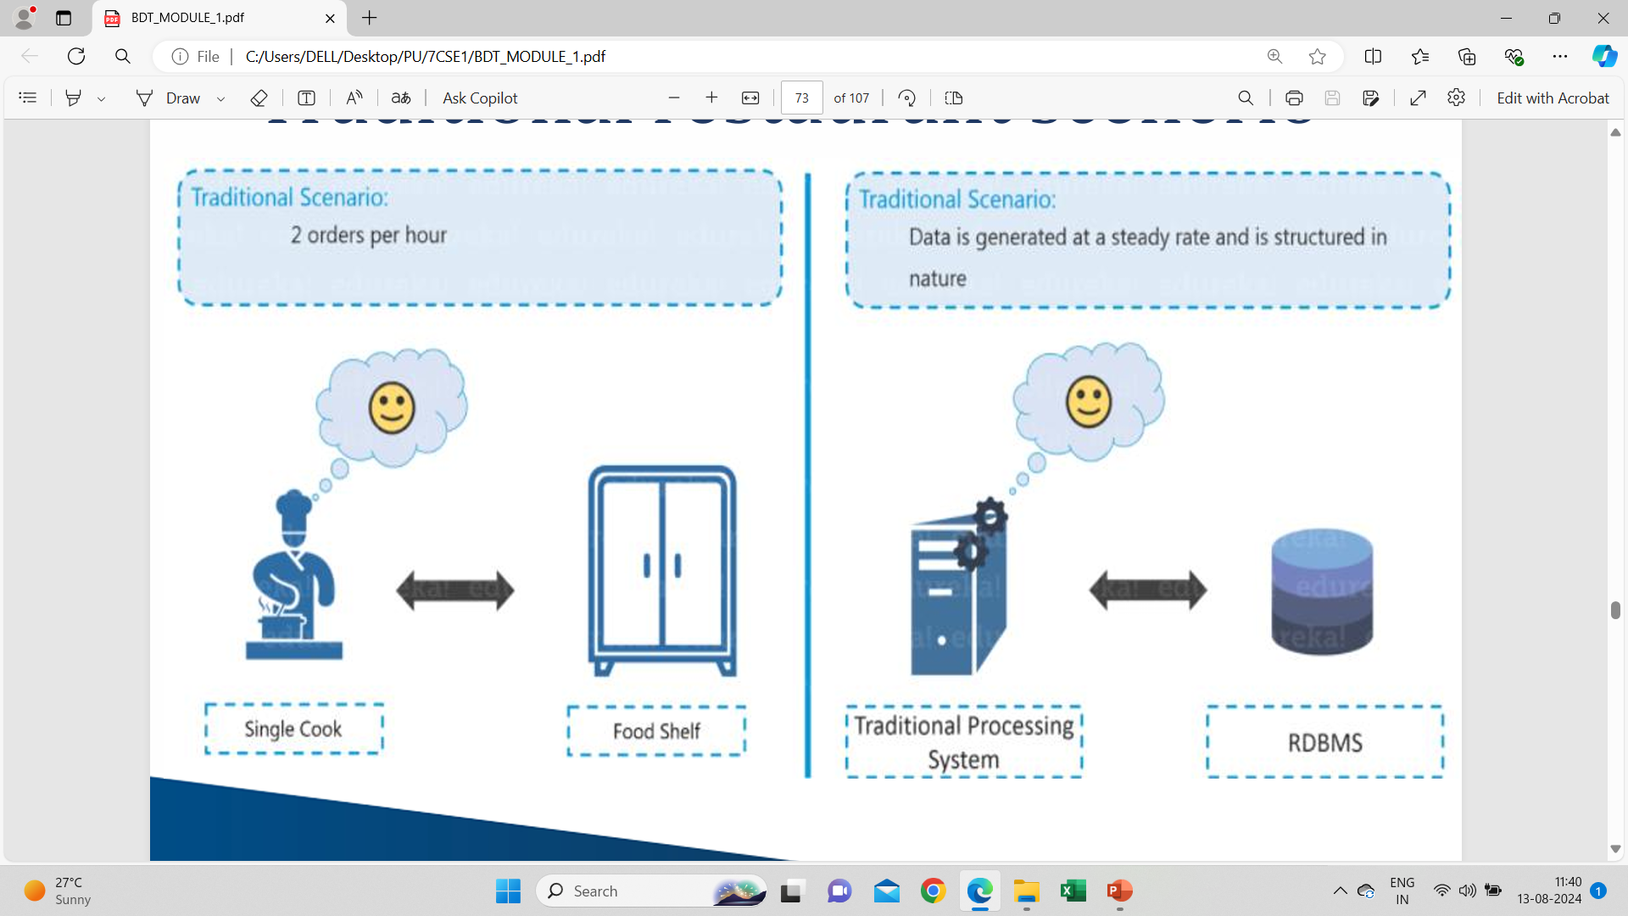
Traditional restaurant scenerio

Slide 43
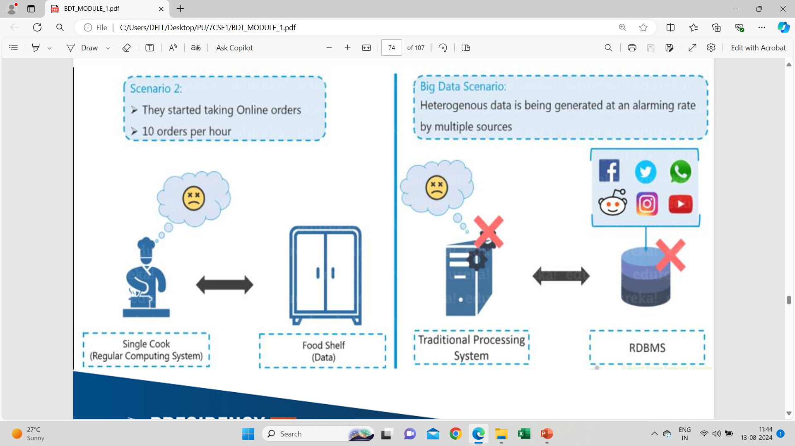
Traditional Scenario

Slide 44
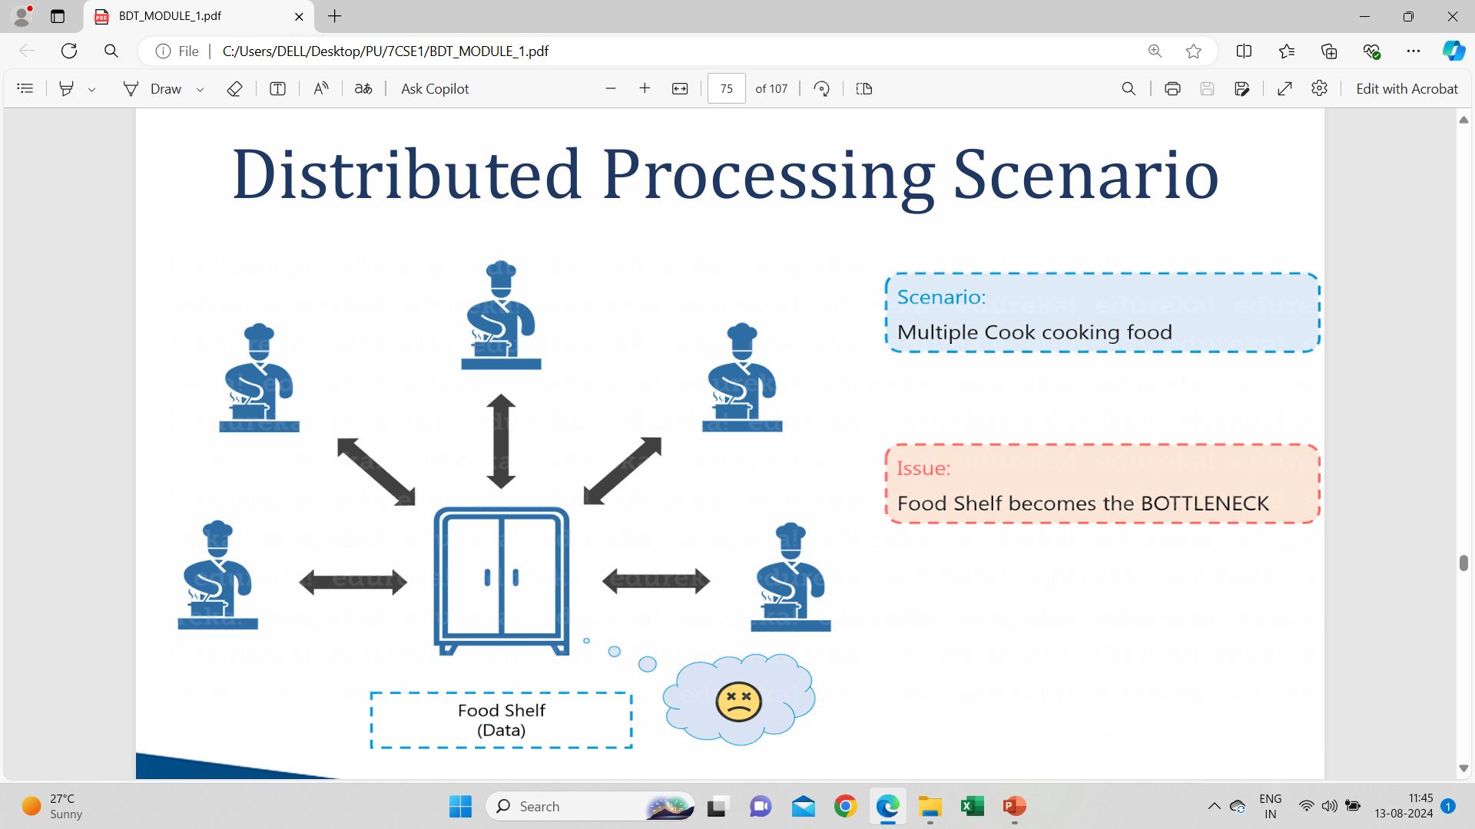
Distributed Processing Scenario

Slide 45
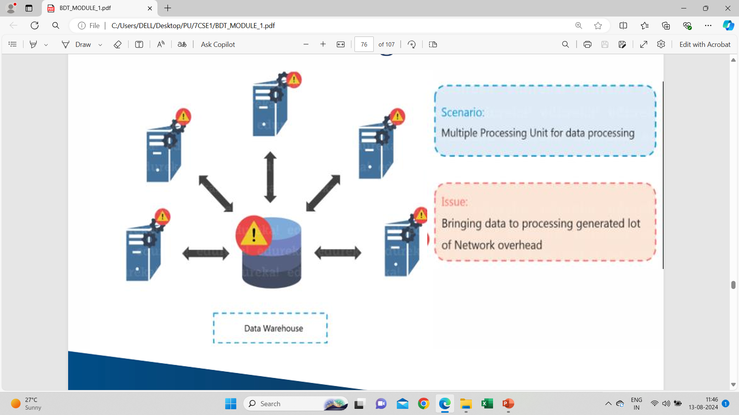
Distributed Processing Scenario Failure

Slide 46
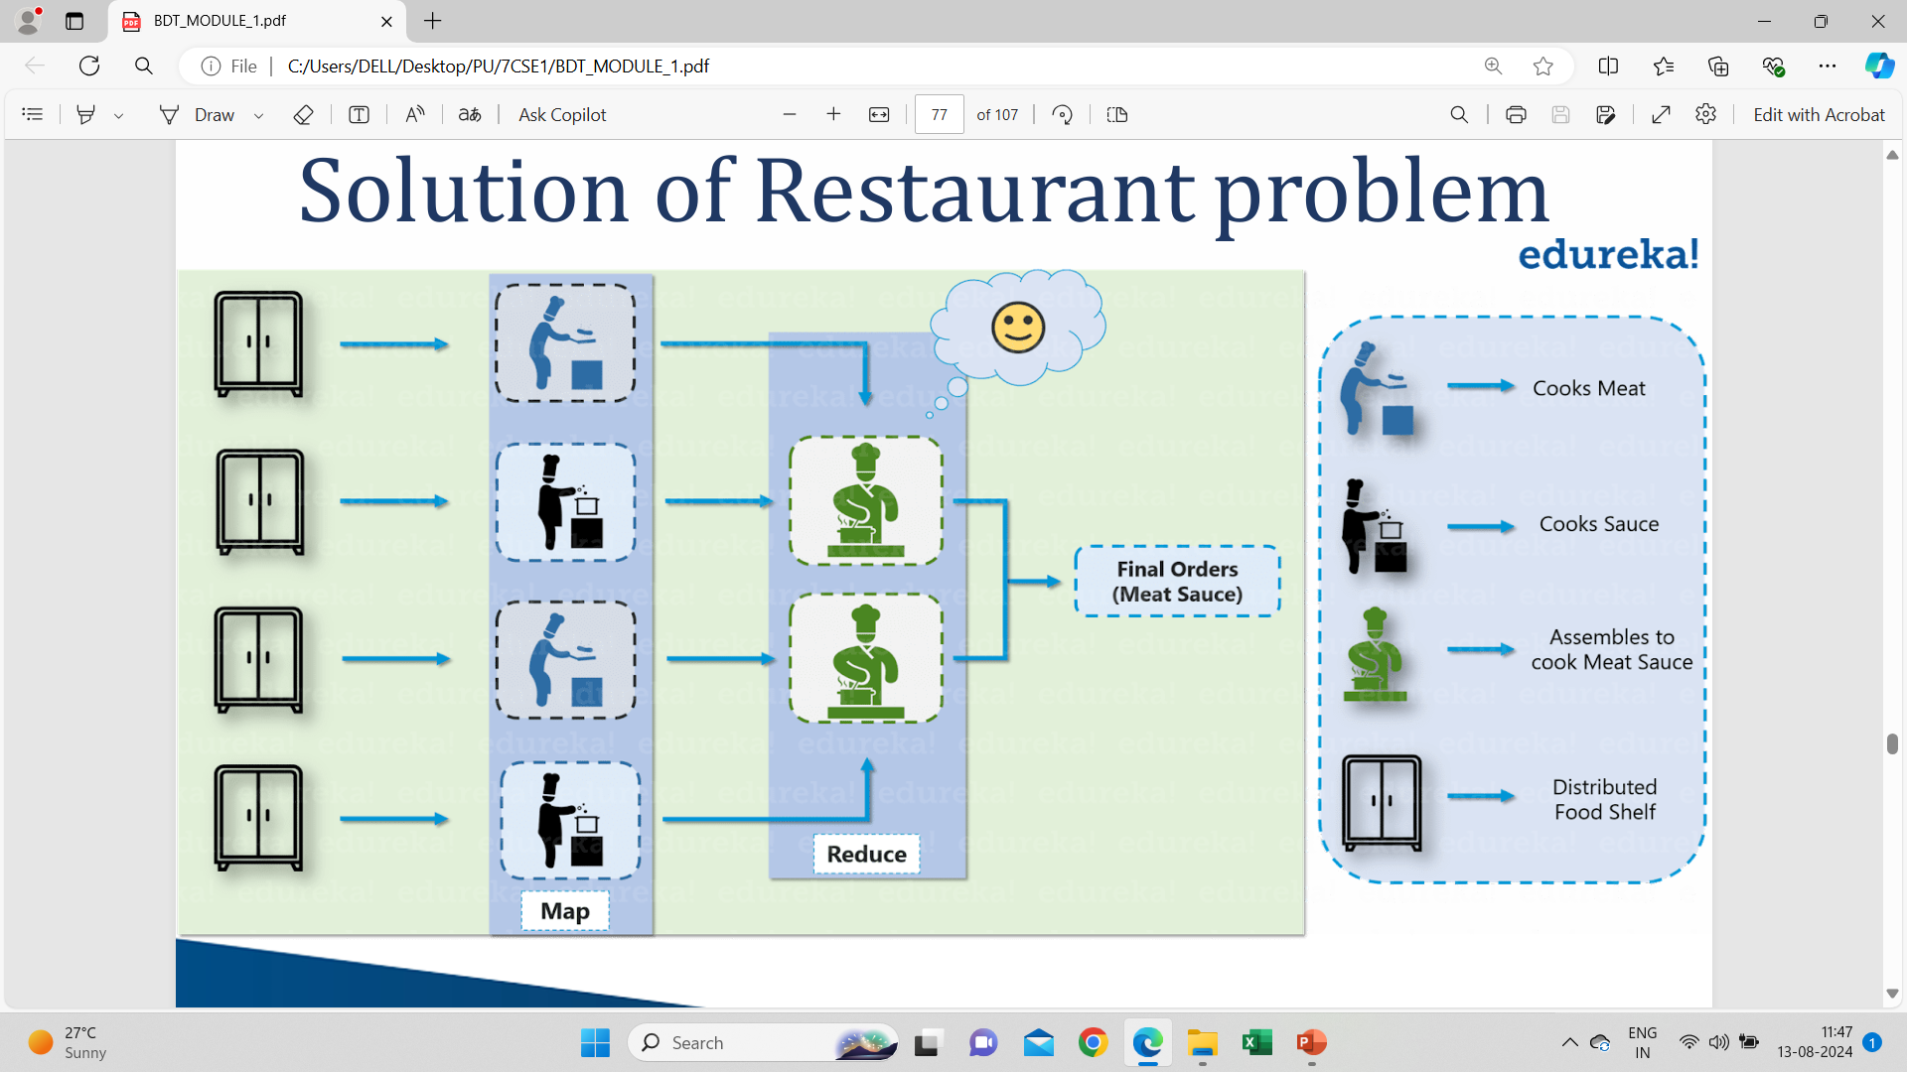
Solution of Restaurant problem

Slide 47
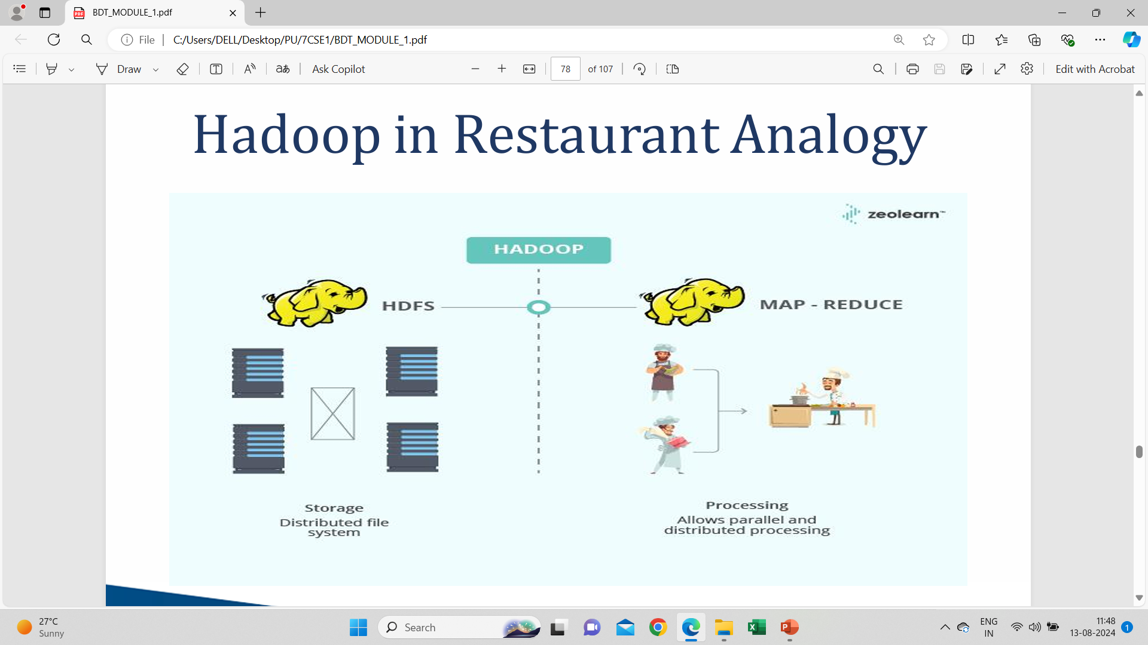
Hadoop in Restaurant Analogy

Slide 48
Map tasks
Process independent chunks
Parallel manner
Stored as intermediate data

Slide 49
Reduce task
Sorts the output based on key
Reduced output by combining the output from various mappers

Slide 50
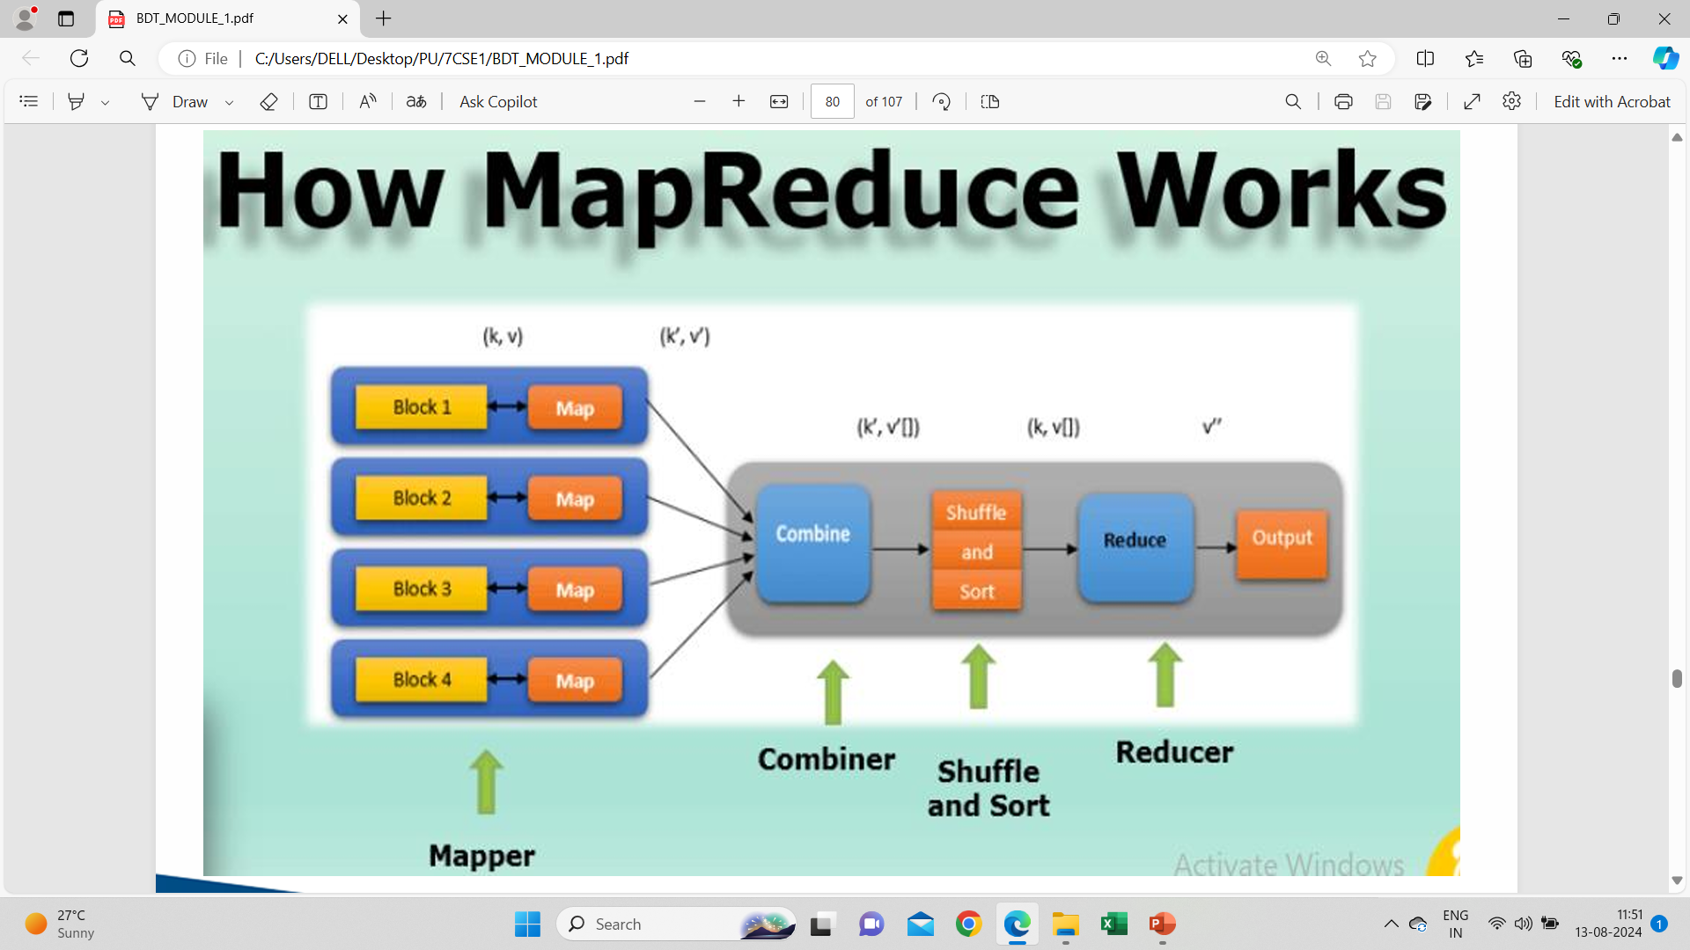

Slide 51
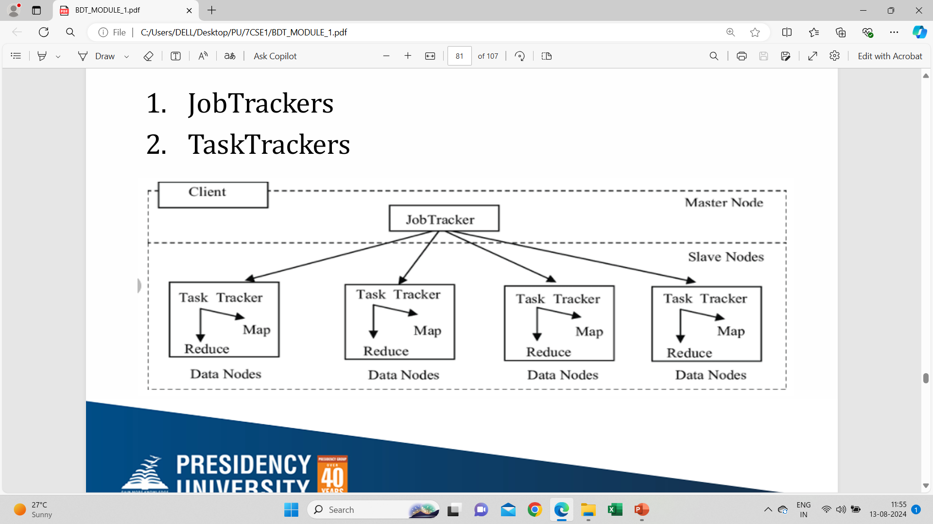
Map-reduce daemons
Job Trackers
Task Trackers

Slide 52
JobTracker
Master daemon
Monitor all running tasks
If task failed then rescheduling

Slide 53
Task Tracker
Single Task Tracker per slave
Continuously sends heartbeat message to Job Tracker
If no heartbeat message then task will be allocated to other Task Trackers

Slide 54
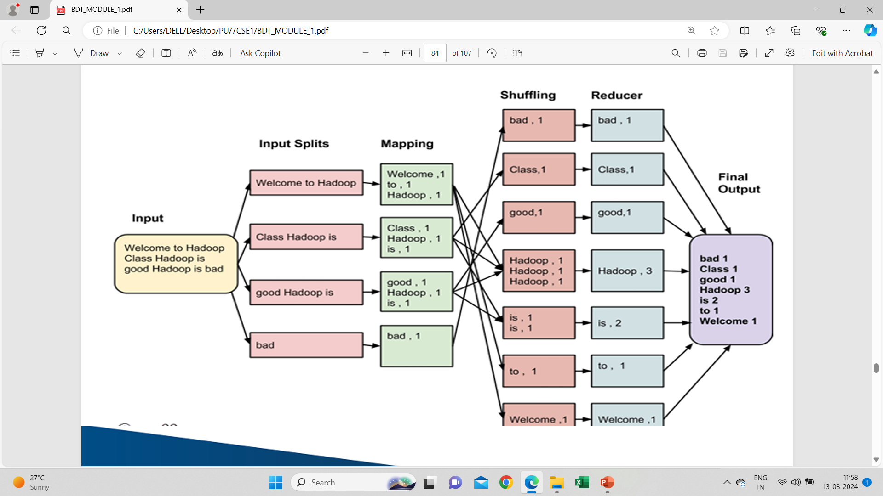
Map-reduce execution pipeline

Slide 55
Mapper
Maps the input key-value pairs.
A set of intermediate key-value pairs is generated.
Phases:
Record Reader
Map
Combiner
Partitioner

Slide 56
Reducer
Shuffle and sort
Reducer
Output format

Slide 57
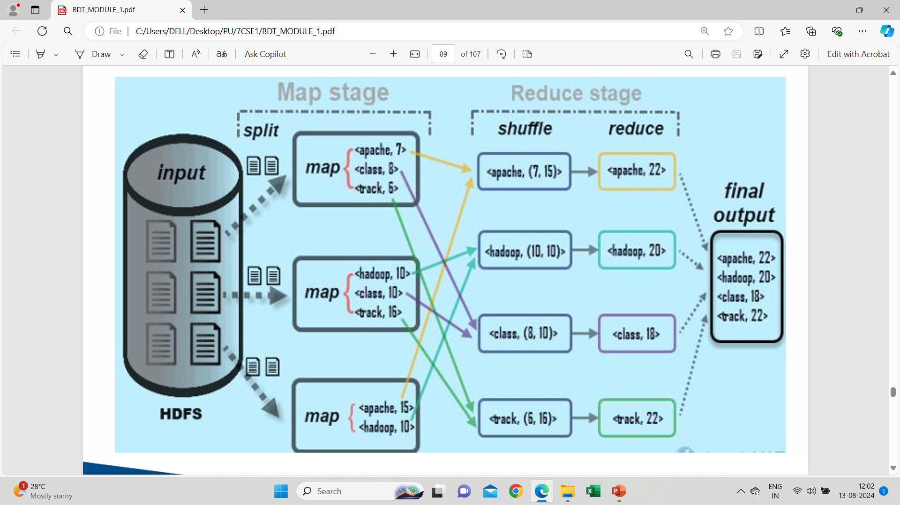

Slide 58
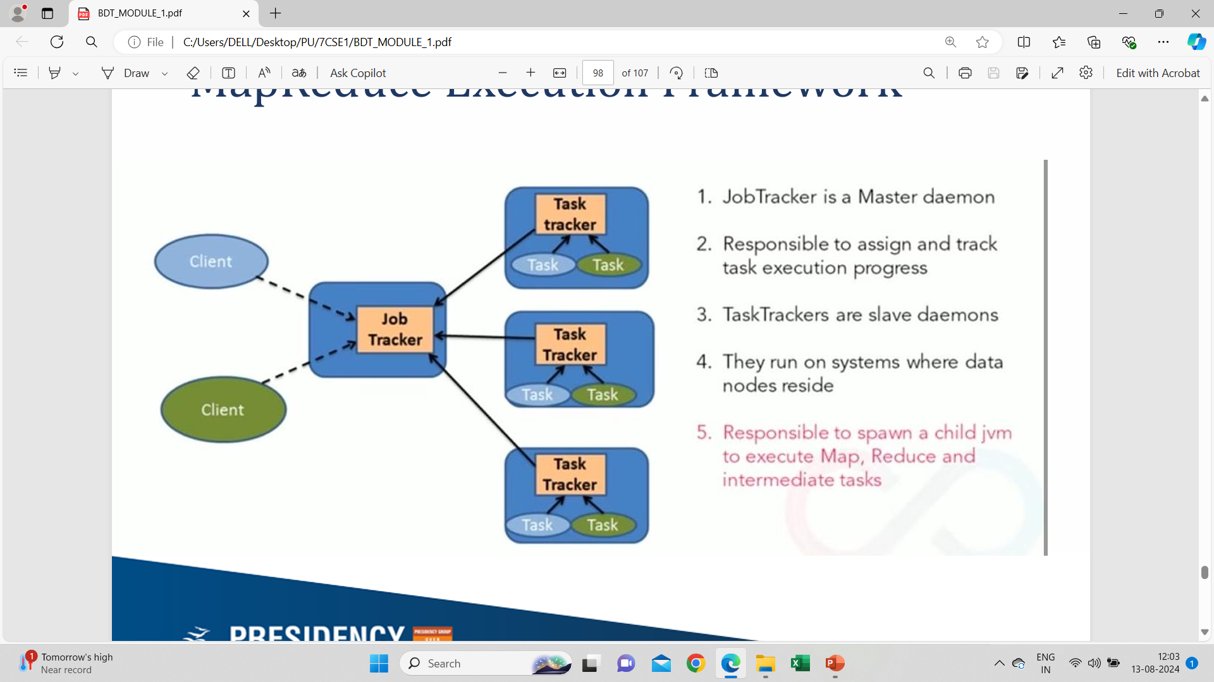
MapReduce Execution Framework

Slide 59
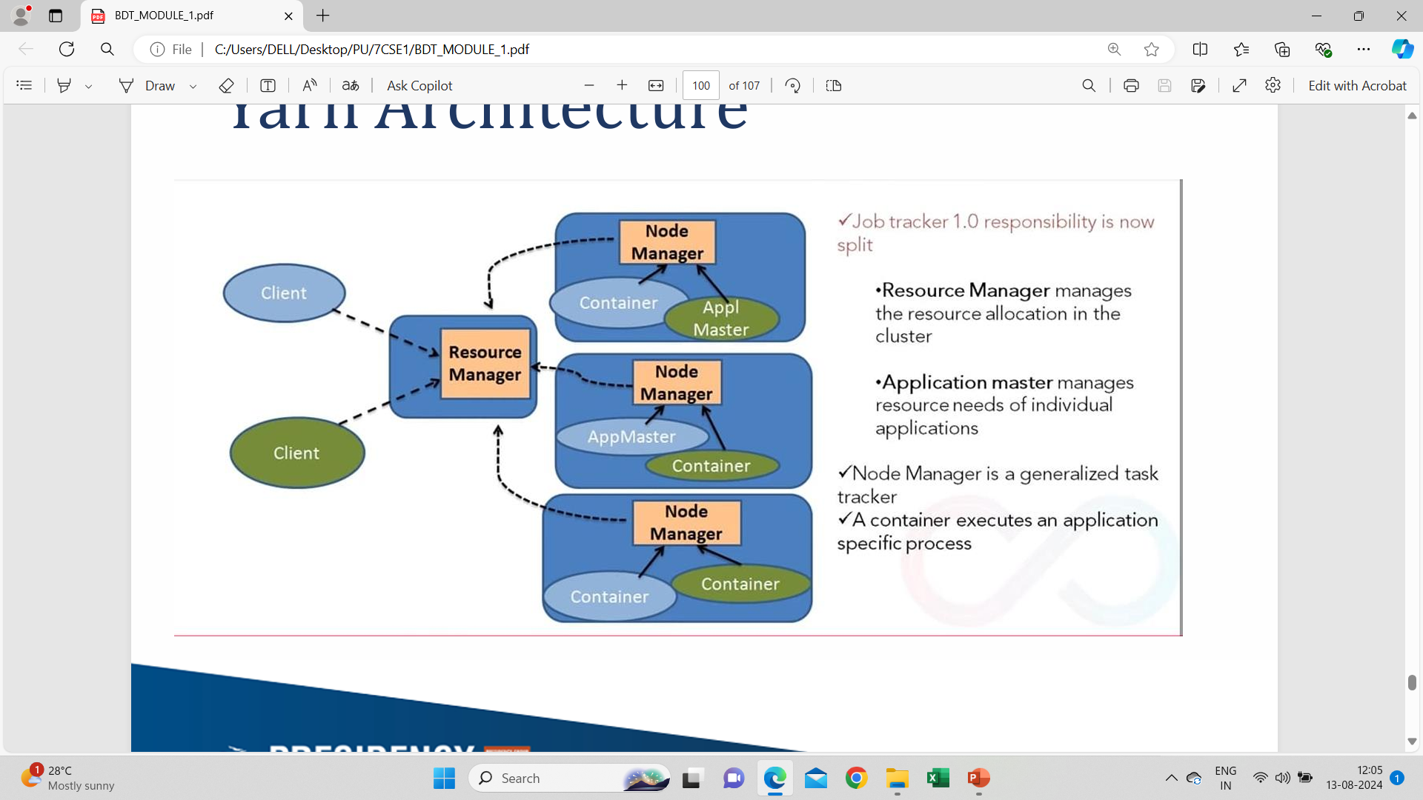
Yarn Architecture

Slide 60
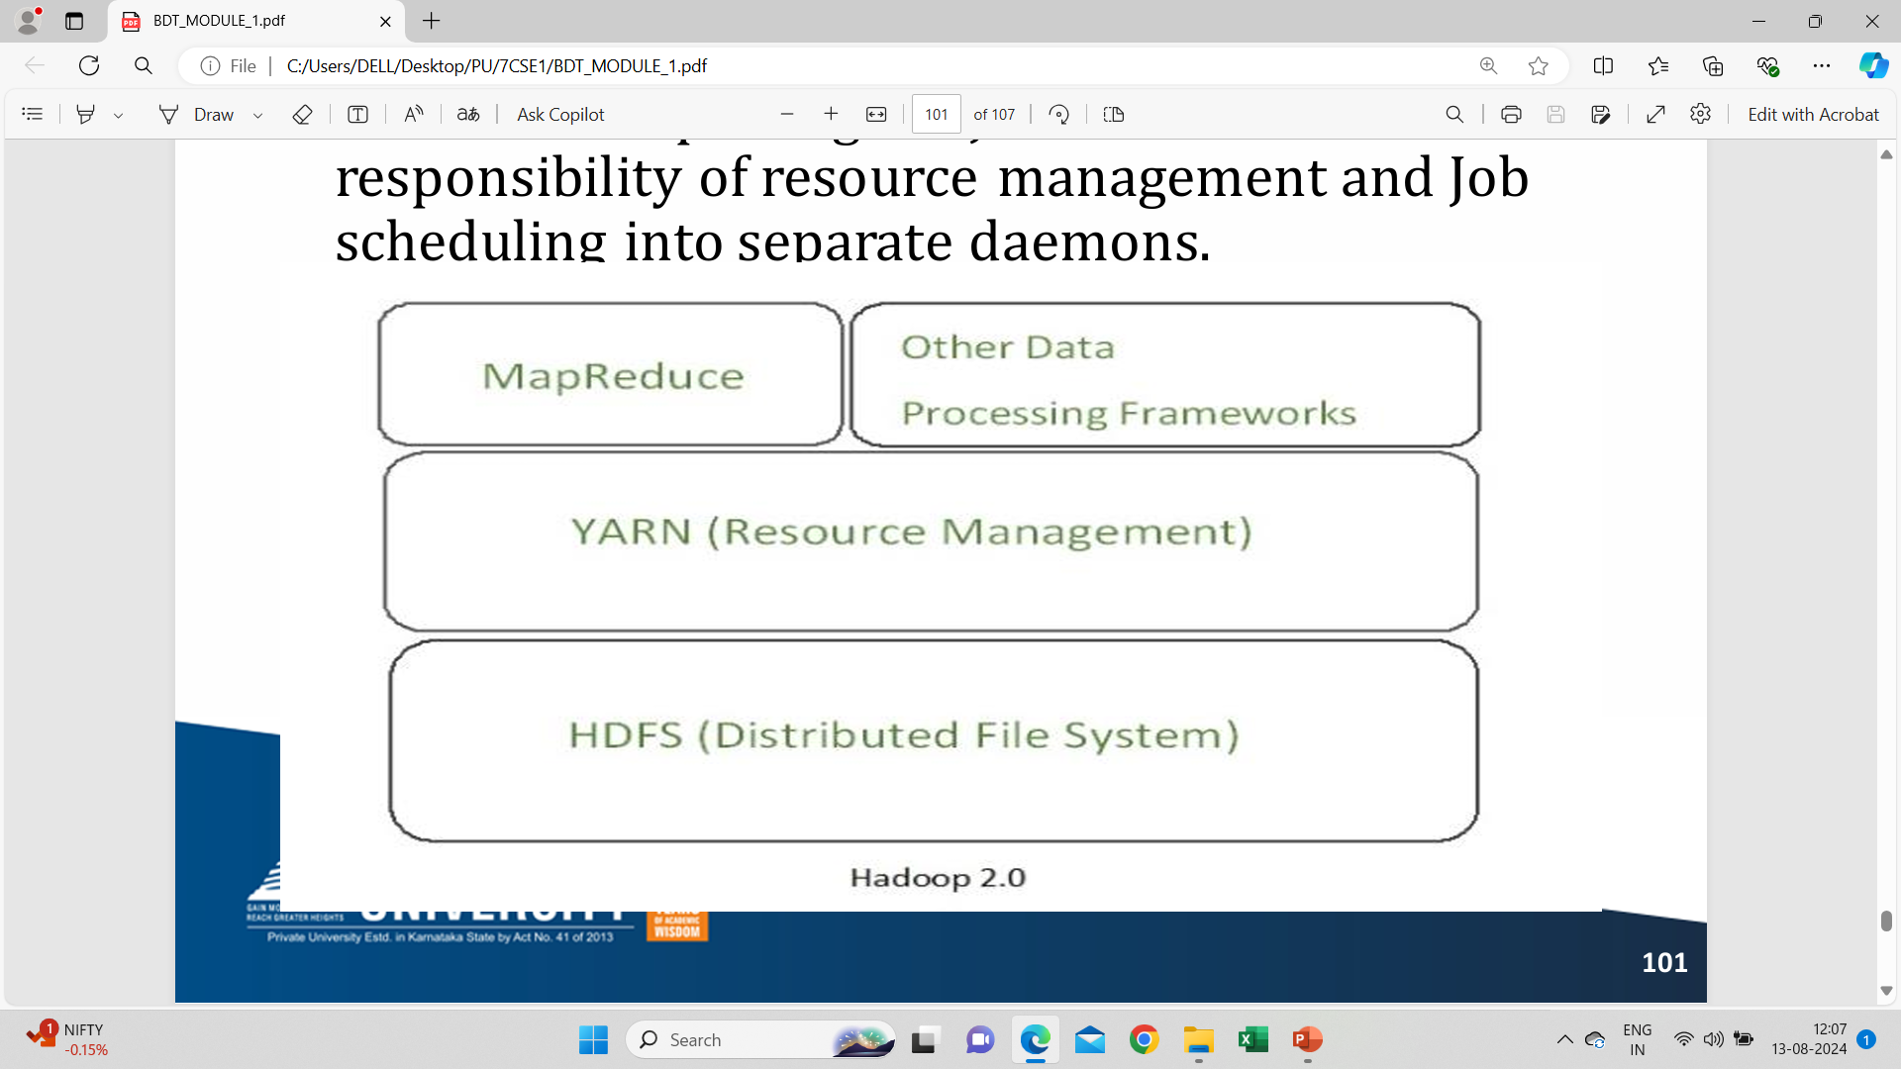
YARN(Yet Another Resource Negotiator)
Splitting the JobTracker responsibility of resource management
Job scheduling into separate daemons.

Slide 61
YARN daemons
Global resource manager
Node manager
Application master

Slide 62
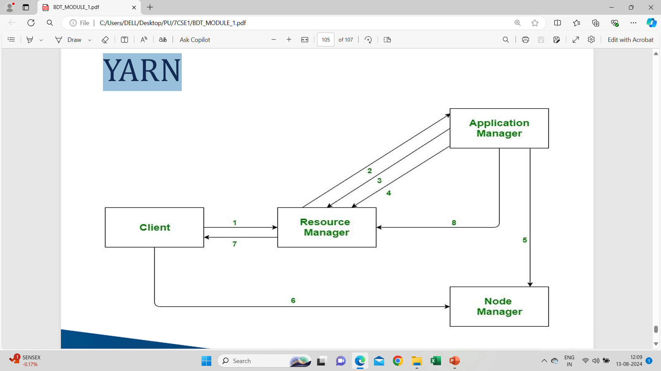
YARN

Slide 63


